Slide 1

















Market Analysis and Overview
Industry Overview and Reasons for Stagnation
Industry Overview
Consumer Segmentation
The thrifting clothing industry involves the buying and selling of pre-owned, second-hand, or vintage clothing.
Growth Drivers
DEMOGRAPHIC
PSYCHOGRAPHIC
BEHAVIORAL
Increased Sustainability Awareness
Age Group
Lifestyle
Usage Rate
Primarily Gen Z and Millennials (ages 18-35) who prioritize sustainability, uniqueness, and personalized fashion.
Eco-conscious
Buyers may purchase seasonally (especially during fall/winter) when demand for jackets and vests peaks.
Affordability, especially students and young adults
Consumers who prefer Environment to Fashion
$1.8 Billion Industry (India, 2023)
Uniqueness and “retro" fashion trend
Socially Conscious Shoppers
Brand Loyalty
With 14.01% CAGR through 2028
Income Level
Who want to stand out with their clothing choices.
The brand focuses on driving repeat purchases and fostering a loyal customers base.
Influencers promoting it as a "trendy" lifestyle.
Middle Income
High Income
Revive Threads Overview
Reasons For Stagnation
“
Revive Threads India is a pioneering thrifting store operating in the burgeoning second-hand clothing market
Competitive Analysis
”
Mission: To make fashion sustainable, affordable, and inclusive.
Vision: To become India's go-to brand for high-quality thrifted fashion, leveraging local partnerships, upcycled collections, and technology to bridge the gap between affordability and sustainability.
Direct Competition
ZINIOSA
RELOVE
REFASH
Primary Data Collection of 200 People
Indirect Competition
Problem Statement
A survey was undertaken indicating that people’s primary concern is Hygiene, with almost 45% people voted for it.
Consumers are unaware about the positive impact created by thrifting industry and also a persistent Social Stigma is present in the market.
They also have a misconception that thrifting clothes are of lousy quality
Facing a plateau in sales growth. Despite continuous efforts to refine its offerings, enhance marketing, the business is encountering challenges in sustaining momentum and achieving consistent revenue growth.
OLX
ZUDIO
H&M
MARKET ANALYSIS AND OVERVIEW
PLANS FOR SUCCESS
APPENDIX
1

Slide 2




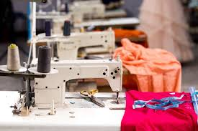

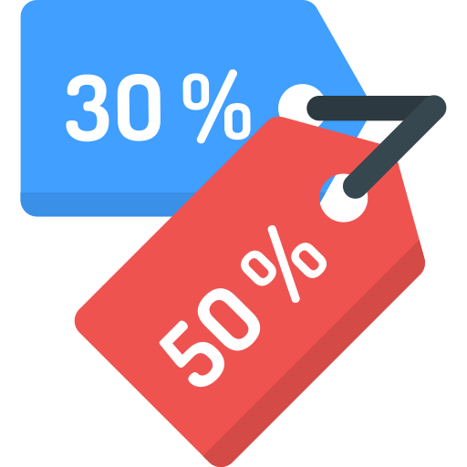

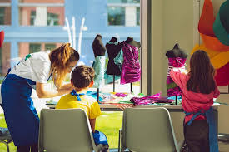











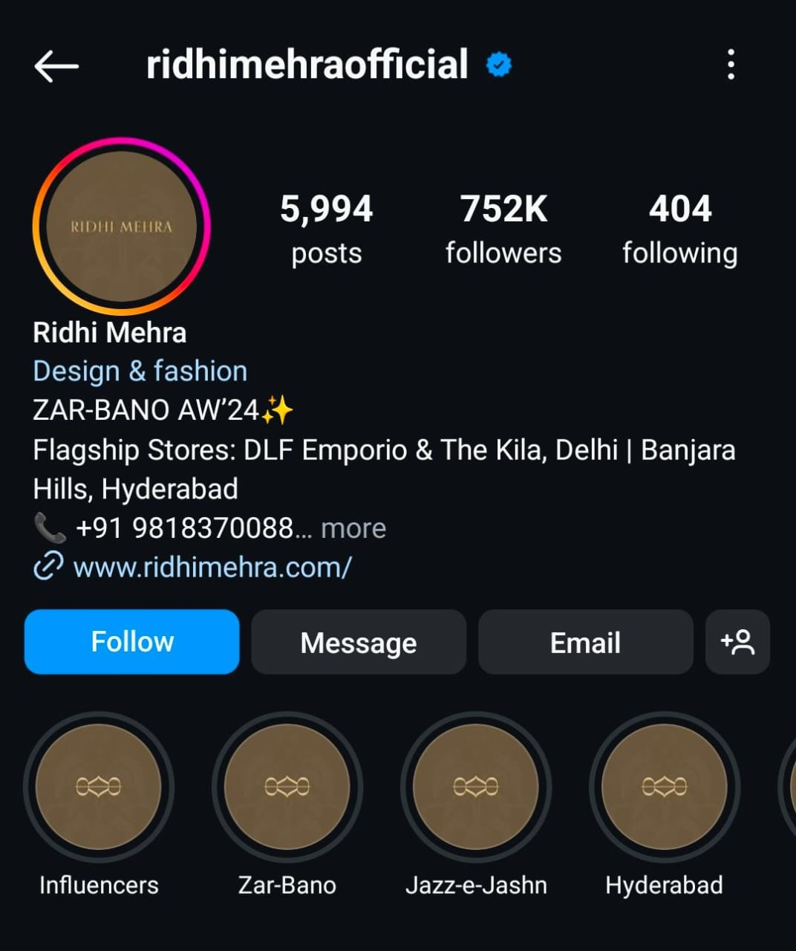




PLANS FOR SUCCESS
How Revive Threads India can build trust and penetrate into the Indian market
Earn & Shop with our Coin Credit System
Initiating Targeted Social Media Campaigns
Return Clothes: Customers return their used clothes for recycling
"Where Fashion Meets Responsibility:
A Peek into Our Process"
Get Coins: Accumulate coins based on the number and type
of clothes returned.
~150-200
~2000-2500
Workshops
per Year
Unlock Discounts: Redeem coins for discounts on
future purchases.
Footfalls
per Fest
Primary Research
"Workshops in College Fests"
Collaborate with Third Party
Life-Cycle Analysis Platform
“Wear Your Values,
Live Your Impact”
Brainstorming
Demonstrates Transparency,
encouraging customer Royalty
Decodes sustainability:
Measure, analyse Carbon Footprints, drives sustainability
Enhanced Brand Reputation Globally
Demonstrate our
Commitment to Sustainability
Partnerships for Eco - solutions
Accurate life cycle impact analysis
Students will redesign old
clothes into new, `
sustainable fashion techniques
Sustainability improvement insights
Involve Customers in
our Brand Story
Selection
Social Media Partnerships
A Step Towards Versatility: Diversifying into different products
Cultural Synergy:
Highlights Indian craftmanship,
matching our Brand’s ethos
Sleepwear – Pyjamas, robes or comfortable lounge sets
"Expanding our product range to include offering eco-friendly options that can be enjoyed privately, free from social stigma."
Execution
Kitchen Aprons -Wears for cooking, not worn outside
Target Audience Overlaps with
the Influencer’ audience
Scarves or Shawls -Worn as accessories, adding warmth & style
Prestige Boost:
Her credibility enhances
our Brand’s Trust & Market Presence
PLANS FOR SUCCESS
APPENDIX
2
1

Slide 3


Slide 4

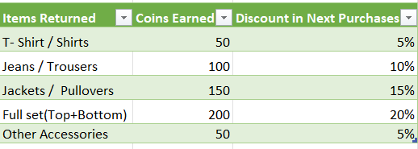
APPENDIX
How THE COIN CREDIT SYSTEM will work
PLANS FOR SUCCESS
APPENDIX

Slide 5


